Slide 1


Interview Plans

Slide 2
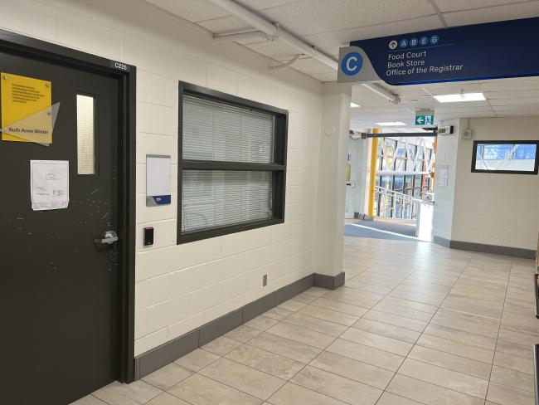
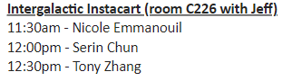
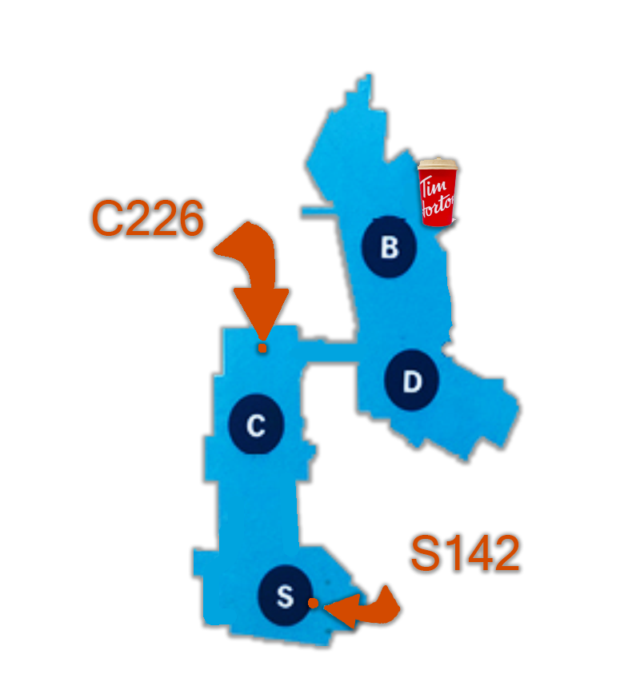
What We Know
Nicole Emmanouil
Serin Chun
Tony Zhang
Resume (Teams)
Resume (Teams)
Resume (Teams)
Portfolio
Portfolio
Portfolio

Slide 3

What We Need
An artist who is qualified to conceptualize and execute on our game’s visual style and construct functional assets for our team’s designers and programmers to implement.

Slide 4

What We Need to Know
Artistic
Technical
Soft
Capability
Experience
Skills

Slide 5
What We Need to Know (or know that we need)
Artistic Capability
Technical Experience
Soft Skills
Colour Theory/Use
Overall Colour Control
Low Poly
Stylistic Fit
Adaptable!
Modular Design
Conceptualization
Solo Work?
Workflow!
3D Modeling
Character & Materials UV
Rigging & Animation
Non-Humanoid/Non-Biped
Tools
Software
Pipelines
Communication
Group Experience
Problem Solving
Time Management
Information retention
Self-Awareness
Strengths
Weaknesses
Availability
In-Person?
Punctuality

Slide 6
What We Need to Do
Decide upon several questions and avenues of conversation that address some, or all, of these mentioned topics.
How?
Each member will bring 3 questions they have for the interview, 1 for each interview pillar.
We will convene tomorrow (Thursday, March 16th) at 1:00pm in order to assess our questions, remove duplicates, merge similar ones, and plan our strategy moving forward.

Slide 7

WE CAN MAKE SOMETHING GREAT TOGETHER

